Slide 1

Broken Authentication & Authorization
Sarwar Jahan M.
Disclaimer: All the views/data presented are my own and do not reflect the opinion of my current/past employer.

Slide 2






Who am I
Sarwar Jahan M.
AppSec Engineer at
Secure Code Review|Web and Mobile App Security|Threat Modelling
Synack & Bugcrowd leaderboard: Top 10 researchers (2016)
Spoken at: n|uCon ’17
sarwarjahanm@outlook.com
@sarwarjahanm
+91 77 9597 8228
https://in.linkedin.com/in/sarwarjahanm

Slide 3
Outline
Authentication?
Authorization?
Case Studies
Authentication Bypass
Case Studies
Broken Authorization and Privilege Escalation
Remediation
Q/A

Slide 4
Authentication

Slide 5

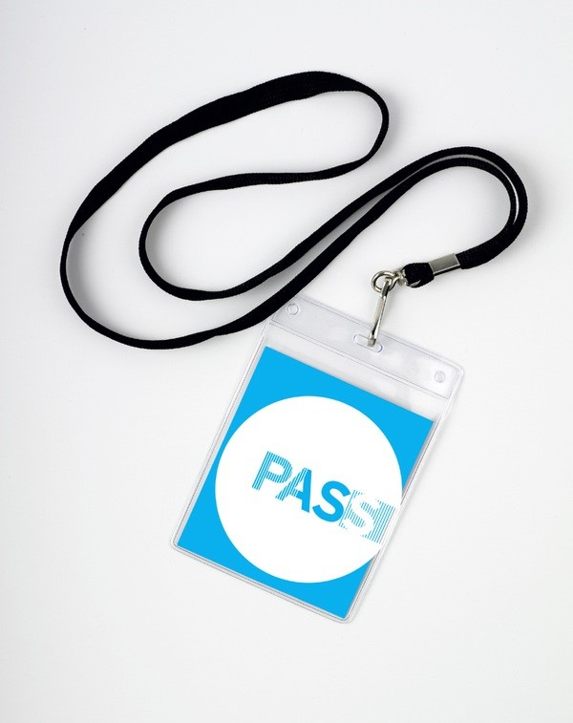


Slide 6
Authorization

Slide 7

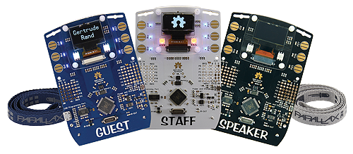
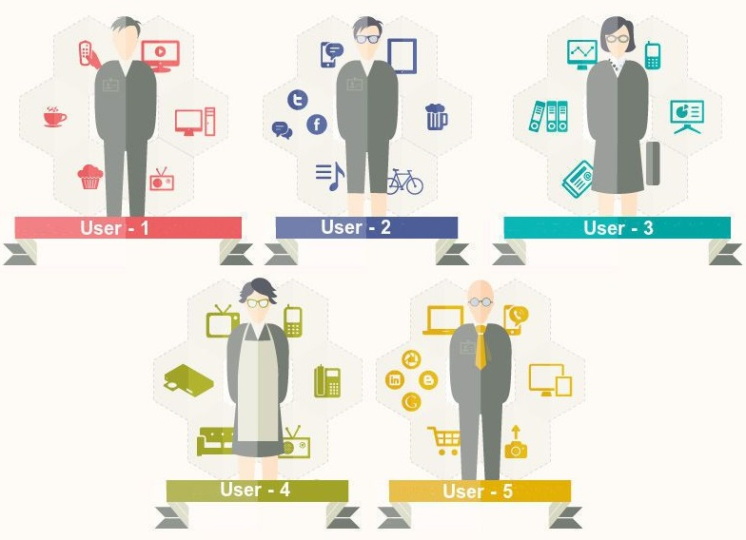

Slide 8
Case Studies
Authentication Bypass

Slide 9

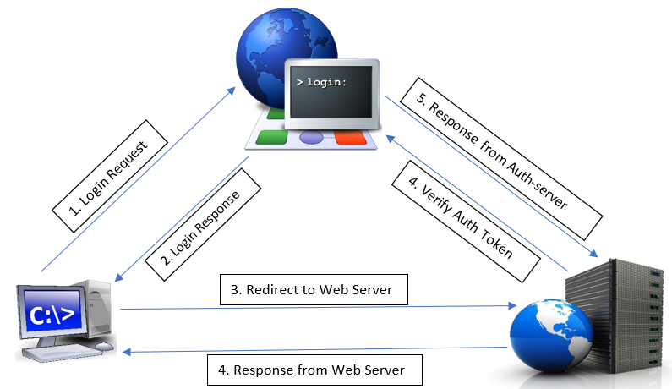
Case 1: Misuse of Auth-token
Login Scenario:
Valid Credential => Login status=Success & Auth-token returned in response
Wrong credential => Login status=Failed & blank Auth-token returned
Attack Scenario:
Attacker (user) submits valid credential.
Intercepts the 1st Login response, copies the Auth-token & drops the response.
Sends login request with Target UserID+wrong Password.
In response, sets Login status=Success & Adds his own Auth-token value.
RESULT: Attacker gets access to Victim’s account!

Slide 10
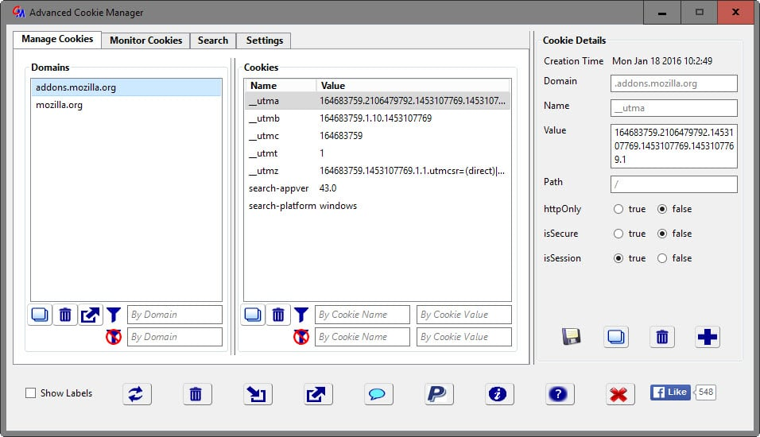
Case 2 – Cookie manipulation
Login Scenario: User-ID in session Cookie
Successful login => App sets session cookie->user-ID (numeric value)
Attack Scenario:
Attacker (user) logs in to application.
Using any cookie editor, replaces the user-ID value in cookie with that of a victim & refreshes the page.
RESULT: Attacker gets access to Victim’s account!

Slide 11

Case 3 - Session Invalidation
Login Scenario:
Multi-login allowed & Session not expired after Password reset (>3 months).
Attack Scenario:
Suppose a user identifies that the account is compromised & changes the password
The active session still remains active and there was no way to invalidate the attacker’s session
RESULT: Once Compromised, attacker gets lifetime access of Victim’s account.

Slide 12
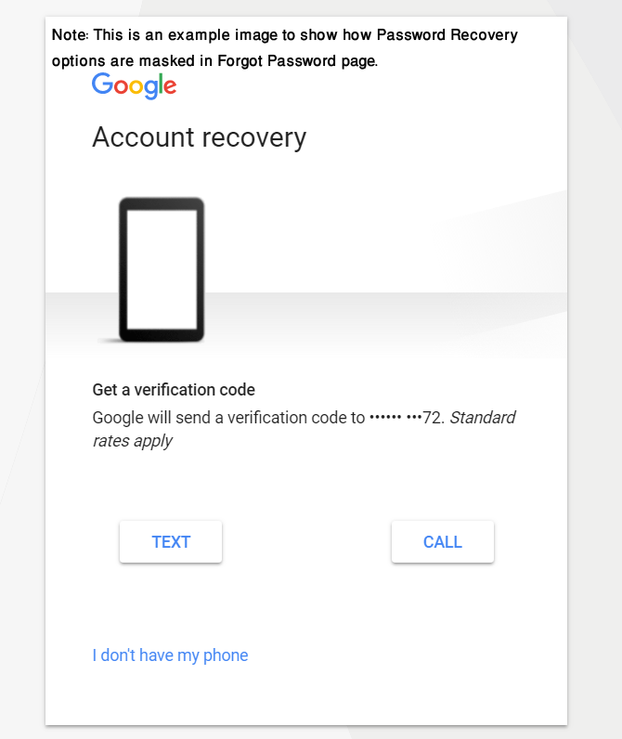
Case 4 – Account takeover by Forgot Password functionality
Password Reset Scenario:
Forgot password page gives option to select recovery option (OTP/email).
Part of the options are masked with asterisk(*).
Attack Scenario:
Attacker provides victim’s user ID in forgot password page.
Selects any recovery option & using proxy tool can see and modify the OTP/email option value in request
RESULT: Attacker receives recovery OTP/email and compromises the victim account

Slide 13


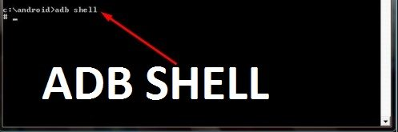
Case 5 – Authentication bypass in Mobile App
Login Scenario:
On successful login, user session was stored in local /AppData/ folder (sqlite db).
Attack Scenario:
After analyzing the sqlite db, it was observed that the stored session is nothing but triple encoding of the username in the format [{username}]
Attacker encodes the victim’s username thrice and pushes in the device’s AppData folder.
Opens the App in device.
RESULT: Attacker gets logged in to victim’s account

Slide 14

Case 6 – Bypass OTP & Transfer Money from Mobile Wallet
WebService Calls:
1st call: UserID+Registered_Mobile_No => OTP sent to registered mobile number
2nd call: Recipient+Amount+OTP => Transfer money
UserID+wrong_Mobile_No => Proper Error message
Recipient+Amount+wrong_OTP => Transaction unsuccessful with proper Error message
Attack Scenario:
UserID+wrong_Mobile_No with symbol ~ => error message reveals Registered_Mobil_No
Initiate valid call to generate OTP (OTP sent to Victim’s mobile so attacker doesn’t have the OTP)
Recipient+Amount+wrong_OTP with symbol ~ error message reveals actual OTP
Recipient+Amount+retrieved OTP => Transaction Successful
RESULT: Forcing Step-by-step error, Attacker debits money from victim’s bank account

Slide 15

Case 7 – Extracting credentials by SQLi
Observation:
All input form-fields seemed secure from SQLi.
After login, the application shows Last Login Time.
Found out that the time stamp was fetched from client system & sent with login request.
Attack Scenario:
After multiple trials, successfully executed a union based SQL injection payload in the timestamp parameter.
RESULT: Attacker fetched credentials of all the users from the database.

Slide 16
Case Studies
Broken Authorization and Privilege Escalation

Slide 17

Case 1 - Boolean based privileges
Application Design:
Application has only two privileges – Admin & normal user.
Keeps track of privilege by Boolean parameter [isAdmin/Admin/SuperManager]=[true/false].
Admins have additional content which are unavailable for normal user.
Attack Scenario:
Attacker who is a Normal low privilege user logs in with valid credential
In response body makes the Boolean value as true
RESULT: Normal user gets admin privilege.

Slide 18
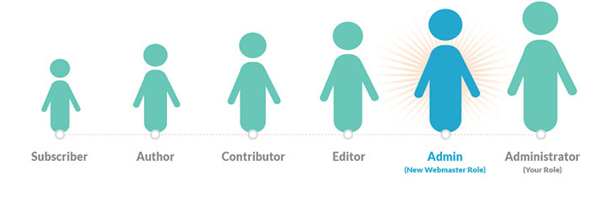
Case 2 – Role based privileges
Application Design:
Application has more than two privileges.
Keeps track of privilege by integer numbers (e,g, role=0|1|2) or Constant Strings (e,g, role=Manager|Admin|user).
Roles stored in cookie.
Attack Scenario:
Attacker logs in as low privilege user.
Edits the cookie and changes the role value
RESULT: Attacker escalates the privilege.

Slide 19
Case 2.1 - Design Flaw – Low priv user updates his role
Application Design:
The PeopleManager (role=1) can create/edit other users with view-only role (role=2). Only super admins (role=0) can change the role of other users or delete users. PeopleManager also cannot edit his own account.
Attack Scenario:
While creating a new user, PeopleManager can use proxy tool and create new users with admin priv by changing role parameter to 0.
While editing other user’s details, PeopleManager replaces the userID with his own, adds “role” parameter to the request and sets the value to 0
RESULT: Low Privilege user updates his role to Super-Admin

Slide 20
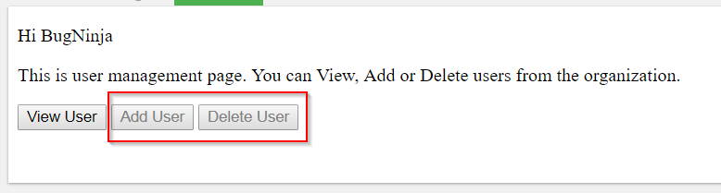
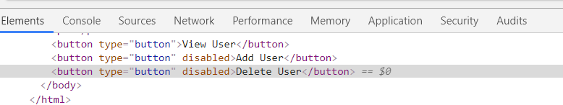
Case 3 - GUI Based/Client-side privilege enforcement
Application Design:
Based on different roles check, the application disables/hides privileged features from low privilege users
E,g, Disabling/Hiding HTML elements
Attack Scenario:
Using browser dev tool (F12), attacker can inspect the elements and remove the rules enforced on the basis of roles. Thus can escalate the privilege and bypass the GUI Based/Client-side privilege enforcement
RESULT: Attacker escalates the privilege and perform disabled/hidden operations.

Slide 21
Case 4 - IDOR to High Priv. pages, Access High Privilege functions
Application Design:
High privileged pages are removed from the view for low privileged users.
Low privilege users are not provided access to sensitive/high privilege functions/features.
Attack Scenarios:
Attacker either guess or finds out the high privileged pages names/references and calls the high privileged pages directly.
Attackers uses Proxy-tool and calls the high privilege function by name which they are not having access.
Because of Missing function level access control, it was possible to call and execute high privilege functions.
RESULT: Attacker gets access to high privileged pages.
Low privilege attacker executes High privilege function.

Slide 22
Case 5 - Design Flaw - user sends SPAM mail to anyone
Application Design:
Normal Users can send mails only to the Team members who are available in drop down recipient list.
Only Admins can send mails to members of different team
Attack Scenario:
Using proxy tool, normal user can modify the recipient address to any non team member’s address also he can change the sender email ID
RESULT: Attacker sends mail to any non-team member person on behalf of someone else (SPAMMING)

Slide 23
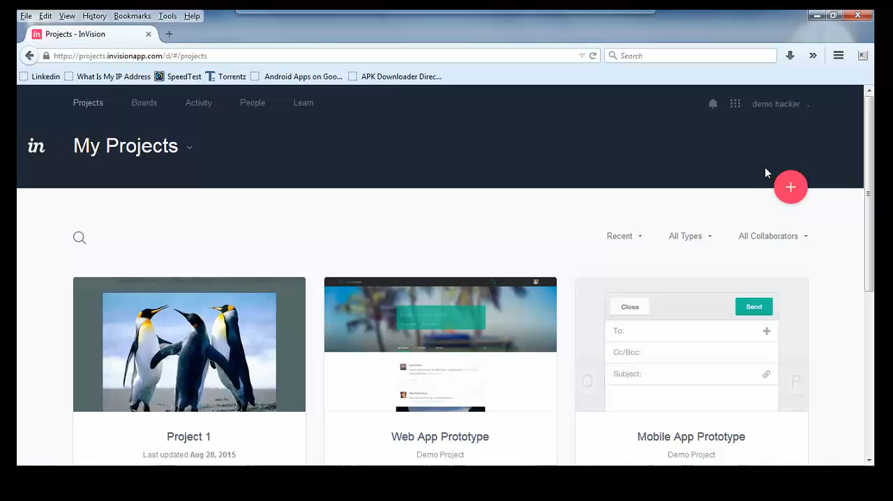
Case 6 – Deleting project by IDOR
Application Design:
A normal user who is not owner can only view a project. There is no delete option for the normal user
Attack Scenario:
Normal user views the Project and copies the Project ID from URL
Normal user himself creates a Project for which he/she becomes owner
Now for this new project delete option is available
Clicks delete and using any proxy tool replaces the ProjectID with that of previous project
RESULT: Normal user deleted a Project for which he/she is not owner but a normal member
Responsible Disclosure: https://hackerone.com/reports/85401

Slide 24
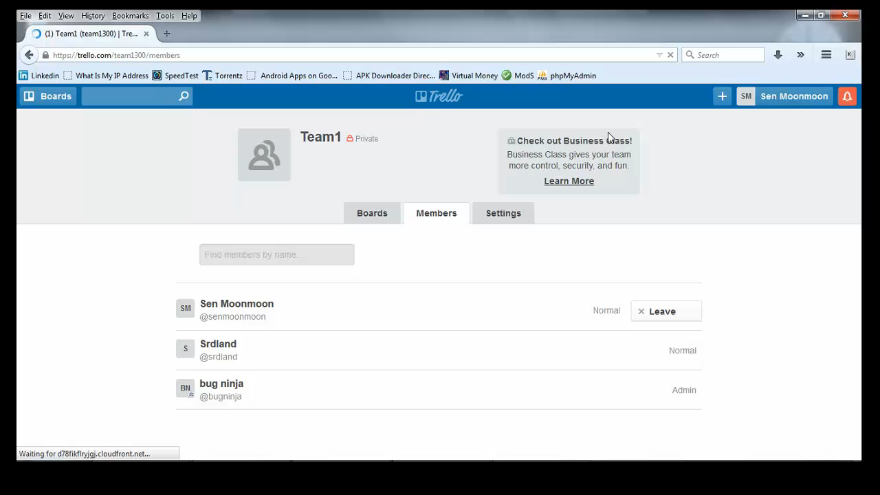
Case 7 – Injecting HTML code snippet
Application Design:
Low privilege normal user doesn’t have permission to add new team members
Attack Scenario:
By adding the following HTML code snippet, a normal user was able to add new team members
<a class="button-link u-gutter js-manage-members" href="#"><span class="icon-sm icon-member"></span> Add Members</a>
RESULT: Low Privilege normal user added New team members which he did not have privilege to do
Responsible Disclosure: https://hackerone.com/reports/92050

Slide 25
Remediation

Slide 26


Remediation - Authentication Bypass
Caption | Check
Mapping of auth-token and userID
Guessable User identifier in cookie
Proper Session invalidation
Strong Password reset functionality
Response body contains debugging error message
App Data contains sensitive information

Slide 27
Remediation - Authorization Bypass
Caption | Check
Map user role with session ID
GUI based/Client-side privilege implementation
Proper Access Control Mechanism
Use IDOR
Server-side validation/Business Logic validation

Slide 28


Questions/Suggestions:
sarwarjahanm@outlook.com
Slides: https://github.com/sarwarjahanm/AuthN_and_AuthZ_Bypass

Slide 29



